Slide 1
DSP-First, 2/e
LECTURE #3
Complex Exponentials
& Complex Numbers

Slide 2
License Info for SPFirst Slides
This work released under a Creative Commons License with the following terms:
Attribution
    The licensor permits others to copy, distribute, display, and perform the work. In return, licensees must give the original authors credit.
Non-Commerical
    The licensor permits others to copy, distribute, display, and perform the work. In return, licensees may not use the work for commercial purposes—unless they get the licensor's permission.
Share Alike
    The licensor permits others to distribute derivative works only under a license identical to the one that governs the licensor's work.
Full Text of the License
This (hidden) page should be kept with the presentation

Slide 3
READING ASSIGNMENTS
This Lecture:
  Chapter 2, Sects. 2-3 to 2-5
Appendix A: Complex Numbers
  Appendix B: MATLAB
  Next Lecture: Complex Exponentials

Slide 4
LECTURE OBJECTIVES
Introduce more tools for manipulating complex numbers
  Conjugate
  Multiplication & Division
  Powers
  N-th Roots of unity

Slide 5
LECTURE OBJECTIVES
Phasors = Complex Amplitude
  Complex Numbers represent Sinusoids
Next Lecture: Develop the ABSTRACTION:
  Adding Sinusoids = Complex Addition
  PHASOR ADDITION THEOREM

Slide 6
WHY? What do we gain?
Sinusoids are the basis of DSP,
  but trig identities are very tedious
Abstraction of complex numbers
  Represent cosine functions
  Can replace most trigonometry with algebra
Avoid all Trigonometric manipulations

Slide 7
COMPLEX NUMBERS
To solve: z² = -1
  z = j
  Math and Physics use z = i
Complex number: z = x + j y
y
z
Cartesian
coordinate
system
x

Slide 8
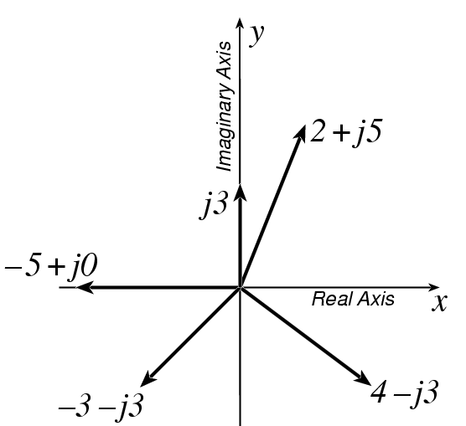
PLOT COMPLEX NUMBERS
Real part:
Imaginary part:

Slide 9
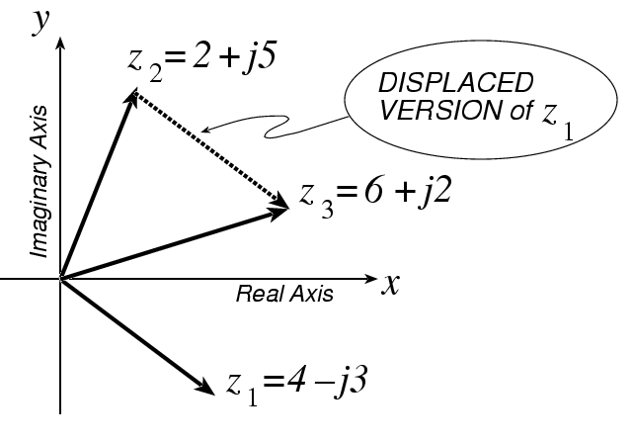
COMPLEX ADDITION = VECTOR Addition

Slide 10
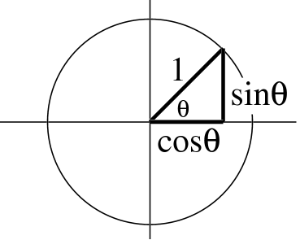
*** POLAR FORM ***
Vector Form
  Length =1
  Angle = θ
Common Values
    j has angle of 0.5π
    −1 has angle of π
    − j has angle of 1.5π
    also, angle of −j could be −0.5π = 1.5π −2π
    because the PHASE is AMBIGUOUS

Slide 11
POLAR <--> RECTANGULAR
Relate (x,y) to (r,θ)
Most calculators do
Polar-Rectangular
Need a notation for POLAR FORM

Slide 12
Euler’s FORMULA
Complex Exponential
  Real part is cosine
  Imaginary part is sine
  Magnitude is one

Slide 13
Cosine = Real Part
Complex Exponential
  Real part is cosine
  Imaginary part is sine

Slide 14
Common Values of exp(jθ)
Changing the angle

Slide 15
COMPLEX EXPONENTIAL
Interpret this as a Rotating Vector
  θ = ωt
  Angle changes vs. time
  ex: ω=20π rad/s
  Rotates 0.2π in 0.01 secs

Slide 16
Cos = REAL PART
Real Part of Euler’s
General Sinusoid
So,

Slide 17
COMPLEX AMPLITUDE
General Sinusoid
Sinusoid = REAL PART of complex exp: z(t)=(Ae^{jφ})e^{jωt}
Complex AMPLITUDE = X, which is a constant

Slide 18
POP QUIZ: Complex Amp
Find the COMPLEX AMPLITUDE for:
Use EULER’s FORMULA:

Slide 19
POP QUIZ-2: Complex Amp
Determine the 60-Hz sinusoid whose COMPLEX AMPLITUDE is:
Convert X to POLAR:

Slide 20
COMPLEX CONJUGATE (z*)
Useful concept: change the sign of all j’s
RECTANGULAR: If z = x + j y, then the complex conjugate is z* = x – j y
POLAR: Magnitude is the same but angle has sign change

Slide 21
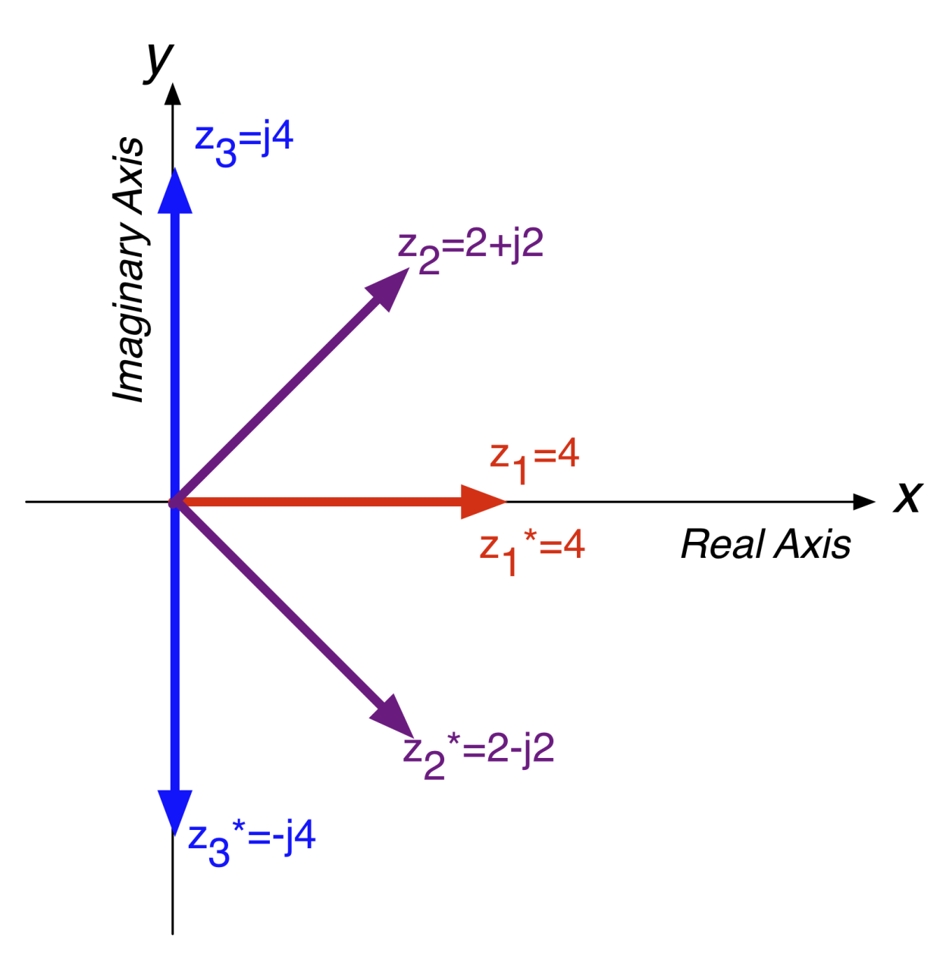
COMPLEX CONJUGATION
Flips vector about the real axis!

Slide 22
USES OF CONJUGATION
Conjugates useful for many calculations
Real part:
Imaginary part:

Slide 23
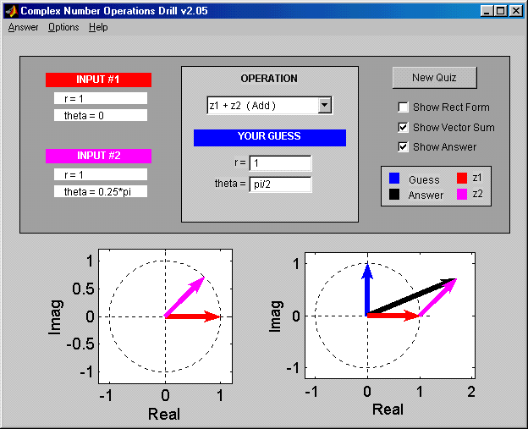
Z DRILL (Complex Arith)

Slide 24
Inverse Euler Relations
Cosine is real part of exp, sine is imaginary part
Real part:
Imaginary part:

Slide 25
Mag & Magnitude Squared
Magnitude Squared (polar form):
Magnitude Squared (Cartesian form):
Magnitude of complex exponential is one:

Slide 26
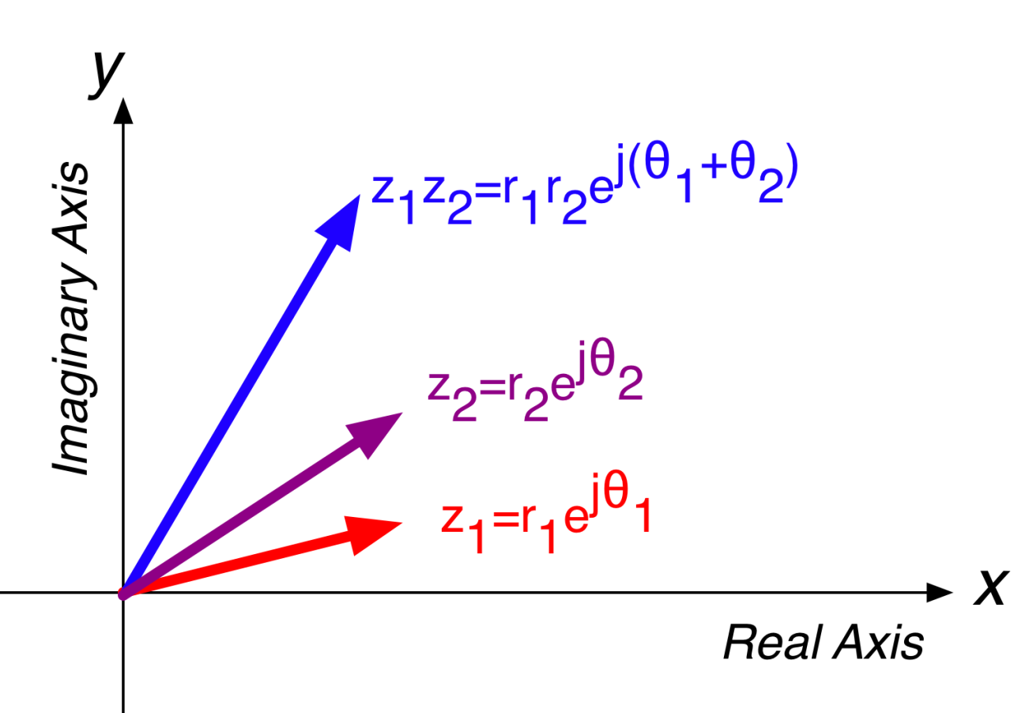
COMPLEX MULTIPLY = VECTOR ROTATION
Multiplication/division scales and rotates vectors

Slide 27
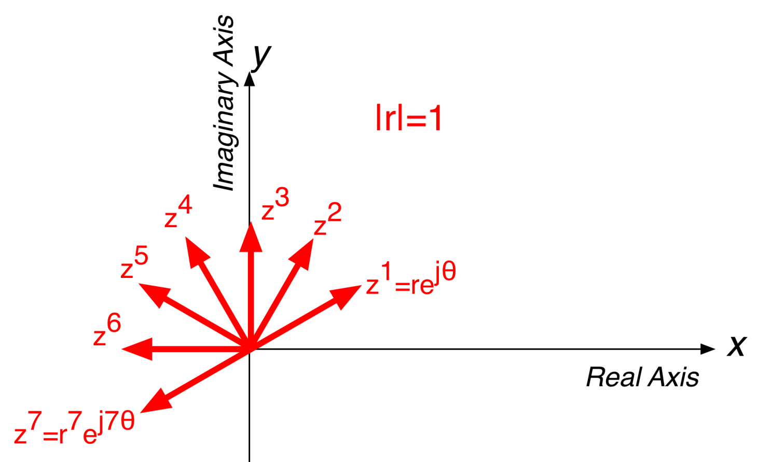
POWERS
Raising to a power N rotates vector by Nθ and scales vector length by r^{N}

Slide 28
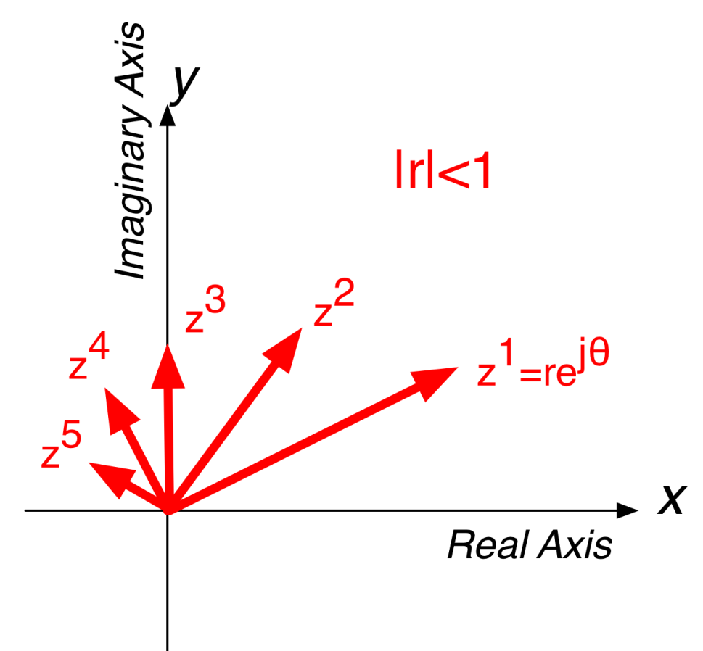
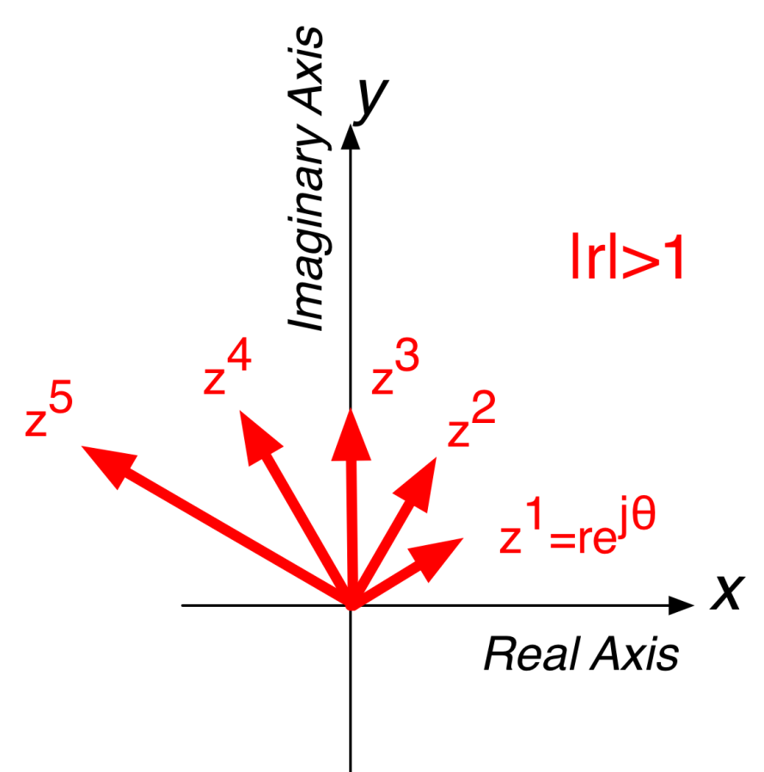
MORE POWERS

Slide 29
ROOTS OF UNITY
We often have to solve z^{N}=1
How many solutions?

Slide 30
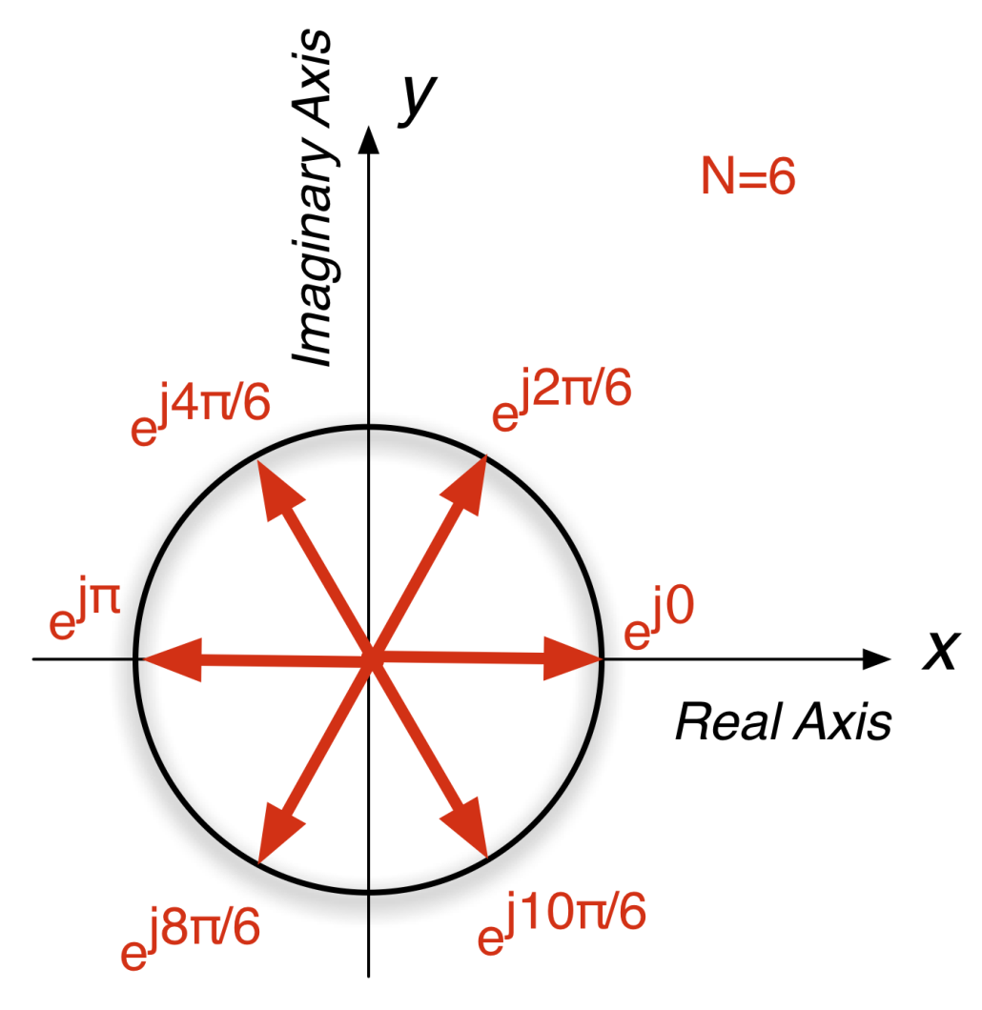
ROOTS OF UNITY for N=6
Solutions to z^{N}=1 are N equally spaced vectors on the unit circle!
What happens if we take the sum of all of them?

Slide 31
Sum the Roots of Unity
Looks like the answer is zero (for N=6)
Write as geometric sum

Slide 32
Integrate Complex Exp
Needed later to describe periodic signals in terms of sinusoids (Fourier Series)
    Especially over one period

Slide 33
BOTTOM LINE
CARTESIAN: Addition/subtraction is most efficient in Cartesian form
POLAR: good for multiplication/division
STEPS:
  Identify arithmetic operation
  Convert to easy form
  Calculate
  Convert back to original form

Slide 34
Harder N-th Roots
Want to solve z^{N} = c
    where c is a complex number

Slide 35
Euler’s FORMULA
Complex Exponential
  Real part is cosine
  Imaginary part is sine
  Magnitude is one

Slide 36
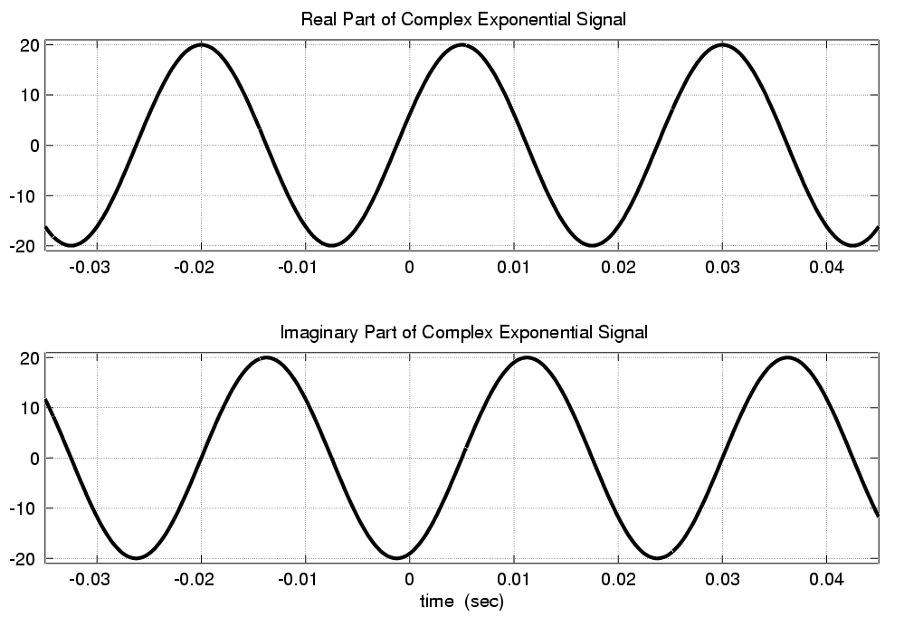
Real & Imaginary Part Plots
PHASE DIFFERENCE = π/2

Slide 37
COMPLEX EXPONENTIAL
Interpret this as a Rotating Vector
  θ = ωt
  Angle changes vs. time
  ex: ω=20π rad/s
  Rotates 0.2π in 0.01 secs

Slide 38
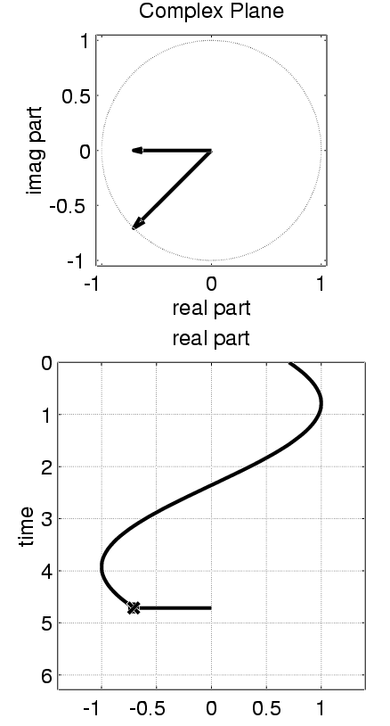
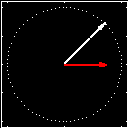
Rotating Phasor
See Demo on CD-ROM
Chapter 2

Slide 39
AVOID Trigonometry
Algebra, even complex, is EASIER !!!
Can you recall cos(θ₁+θ₂) ?
Use: real part of e^{j(θ1+θ2)} = cos(θ₁+θ₂)

Slide 40
MULTIPLICATION
CARTESIAN: use polynomial algebra
POLAR: easier because you can leverage the properties of exponentials
Multiply the magnitudes and add the angles

Slide 41
DIVISION
CARTESIAN: use complex conjugate to convert to multiplication:
POLAR: simpler to subtract exponents

Slide 42
Complex Numbers
WHY? need to ADD sinusoids
Use an ABSTRACTION
  Complex Amplitude, X, has mag & phase
  Complex Exponential
  Euler’s Formula

