Slide 1
DSP First, 2/e
Lecture 5
Spectrum Representation

Slide 2
License Info for SPFirst Slides
This work released under a Creative Commons License with the following terms:
Attribution
The licensor permits others to copy, distribute, display, and perform the work. In return, licensees must give the original authors credit.
Non-Commercial
The licensor permits others to copy, distribute, display, and perform the work. In return, licensees may not use the work for commercial purposes—unless they get the licensor's permission.
Share Alike
The licensor permits others to distribute derivative works only under a license identical to the one that governs the licensor's work.
Full Text of the License
This (hidden) page should be kept with the presentation

Slide 3
READING ASSIGNMENTS
This Lecture:
Chapter 3, Section 3-1
Other Reading:
Appendix A: Complex Numbers

Slide 4
LECTURE OBJECTIVES
Sinusoids with DIFFERENT Frequencies
SYNTHESIZE by Adding Sinusoids
SPECTRUM Representation
Graphical Form shows DIFFERENT Freqs

Slide 5
FREQUENCY DIAGRAM
Want to visualize relationship between frequencies, amplitudes and phases
Plot Complex Amplitude vs. Frequency
Complex amplitude
–250
–100
0
100
250
Spectral line
f (in Hz)

Slide 6
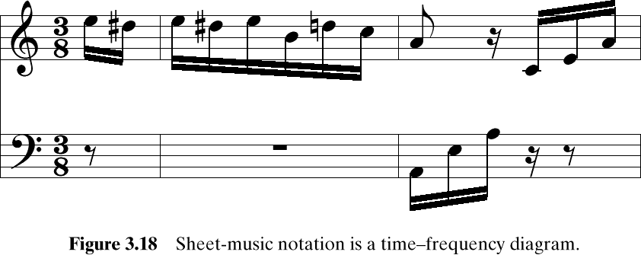
Another FREQ. Diagram
A-440
Frequency is the vertical axis
Time is the horizontal axis
A musical scale consists of a discrete set of frequencies.

Slide 7
MOTIVATION
Synthesize Complicated Signals
Musical Notes
Piano uses 3 strings for many notes
Chords: play several notes simultaneously
Human Speech
Vowels have dominant frequencies
Application: computer generated speech
Can all signals be generated this way?
Sum of sinusoids?

Slide 8
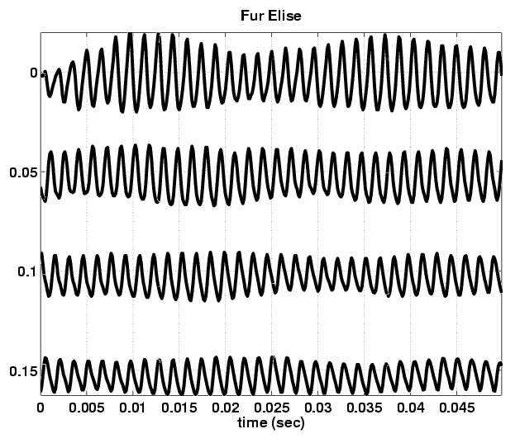
Fur Elise WAVEFORM
Beat
Notes

Slide 9
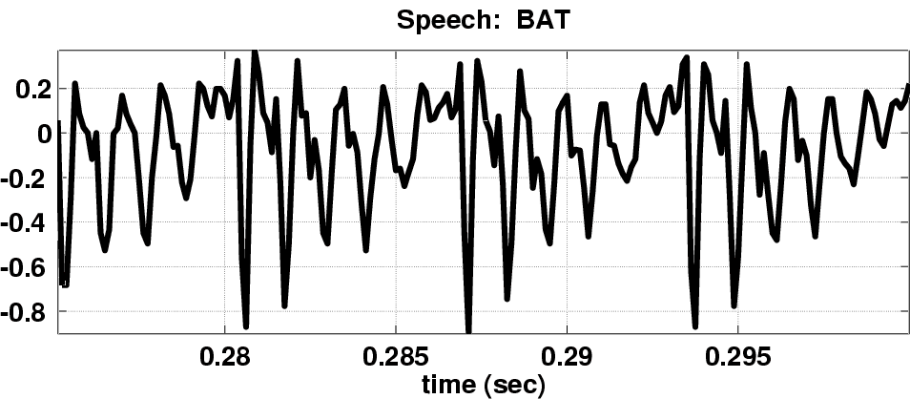
Speech Signal: BAT
Nearly Periodic in Vowel Region
Period is (Approximately) T = 0.0065 sec

Slide 10
Euler’s Formula Reversed
Solve for cosine (or sine)

Slide 11
INVERSE Euler’s Formula
What is the “spectrum” representation for a single sinusoid?
Solve Euler’s formula for cosine (or sine)

Slide 12
SPECTRUM Interpretation
Cosine = sum of 2 complex exponentials:
One has a positive frequency
The other has negative freq.
Amplitude of each is half as big

Slide 13
GRAPHICAL SPECTRUM
-7
0
7
ω
Freq. in rad/s
AMPLITUDE, PHASE & FREQUENCY are labels

Slide 14
NEGATIVE FREQUENCY
Is negative frequency real?
Doppler Radar provides intuition
Police radar measures speed by using the Doppler shift principle
Let’s assume 400Hz ←→60 mph
+400Hz means towards the radar
-400Hz means away (opposite direction)
Think of a train whistle

Slide 15
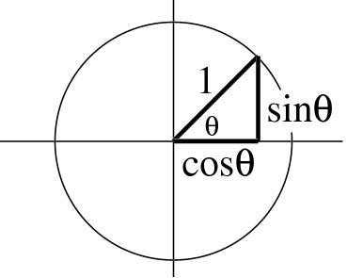
Negative Frequency is still a rotating phasor
View as vector rotating counterclockwise
θ = ωt
Angle changes vs. time
Negative frequency ➔ clockwise rotation

Slide 16
General form of sinusoid spectrum
General form:
Amplitudes are multiplied by ½
Complex amplitudes are complex conjugates
Called conjugate symmetry

Slide 17
SPECTRUM Interpretation
Cosine = sum of 2 complex exponentials:
One has a positive frequency
The other has negative freq.
Amplitude of each is half as big

Slide 18
Recall SPECTRUM of cosine
-7
0
7
ω
Freq. in rad/s
AMPLITUDE, PHASE & FREQUENCY are labels

Slide 19
REPRESENTATION of SINE
Sine = sum of 2 complex exponentials:
Positive freq. has phase = -0.5π
Negative freq. has phase = +0.5π

Slide 20
GRAPHICAL Spectrum of sine
EXAMPLE of SINE (has Phase of –π/2)
-7
0
7
ω
AMPLITUDE, PHASE & FREQUENCY are labels

Slide 21
SPECTRUM ---> SINUSOID
Add the spectrum components:
–250
–100
0
100
250
f (in Hz)
What is the formula for the signal x(t)?

Slide 22
Gather (A,ω,φ) information
Frequencies:
-250 Hz
-100 Hz
0 Hz
100 Hz
250 Hz
Amplitude & Phase
4 -π/2
7 +π/3
10 0
7 -π/3
4 +π/2
Note the conjugate phase
DC is another name for zero-freq component
DC component always has φ=0 or π (for real x(t) )

Slide 23
Add Spectrum Components-1
Frequencies:
-250 Hz
-100 Hz
0 Hz
100 Hz
250 Hz
Amplitude & Phase
4 -π/2
7 +π/3
10 0
7 -π/3
4 +π/2

Slide 24
Add Spectrum Components-2
–250
–100
0
100
250
f (in Hz)

Slide 25
Simplify Components
Use Euler’s Formula to get REAL sinusoids:

Slide 26
FINAL ANSWER
So, we get the general form:

Slide 27
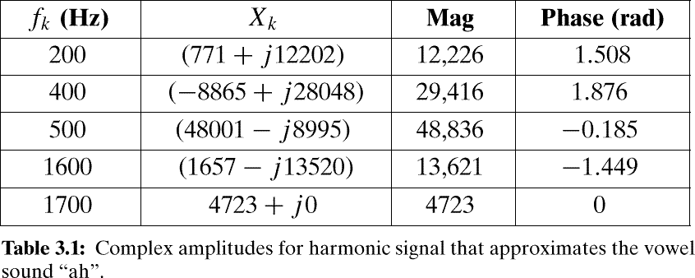
Example: Synthetic Vowel
Sum of 5 Frequency Components

Slide 28
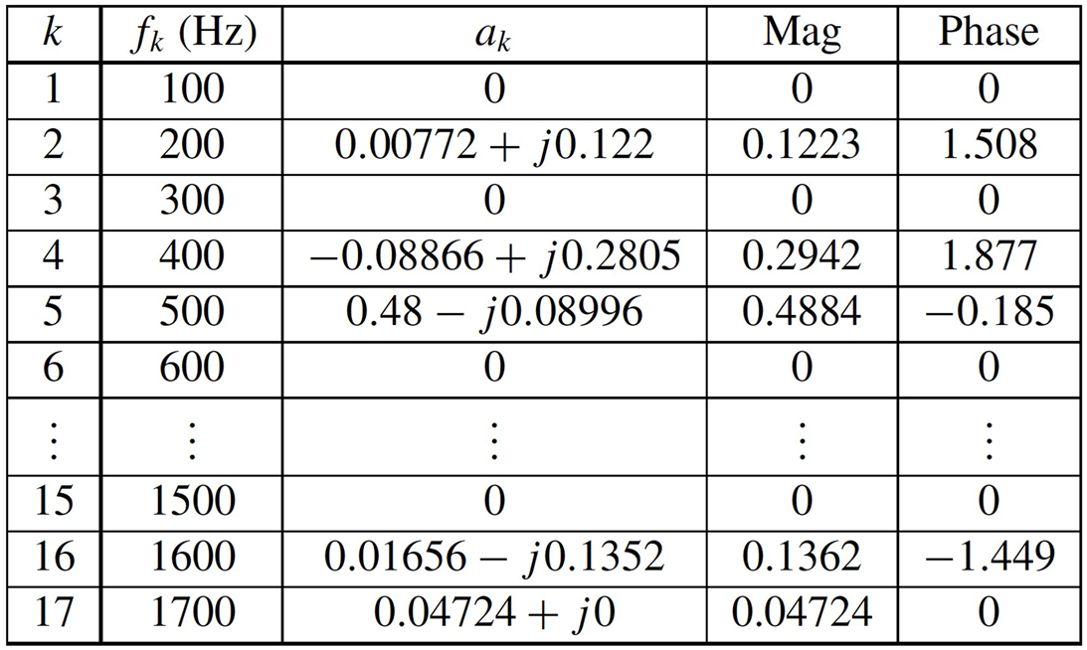
Example: Synthetic Vowel
Sum of 5 Frequency Components

Slide 29
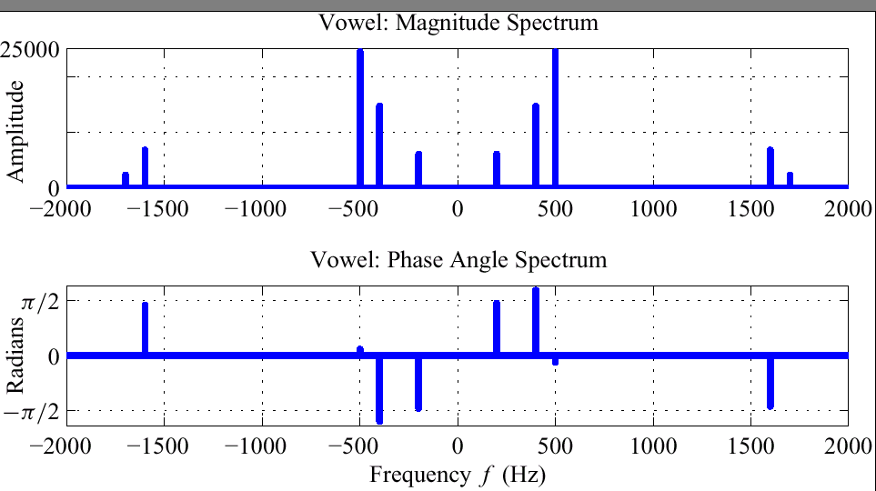
SPECTRUM of VOWEL (Polar Format)
0.5A_{k}
φ_{k}

Slide 30
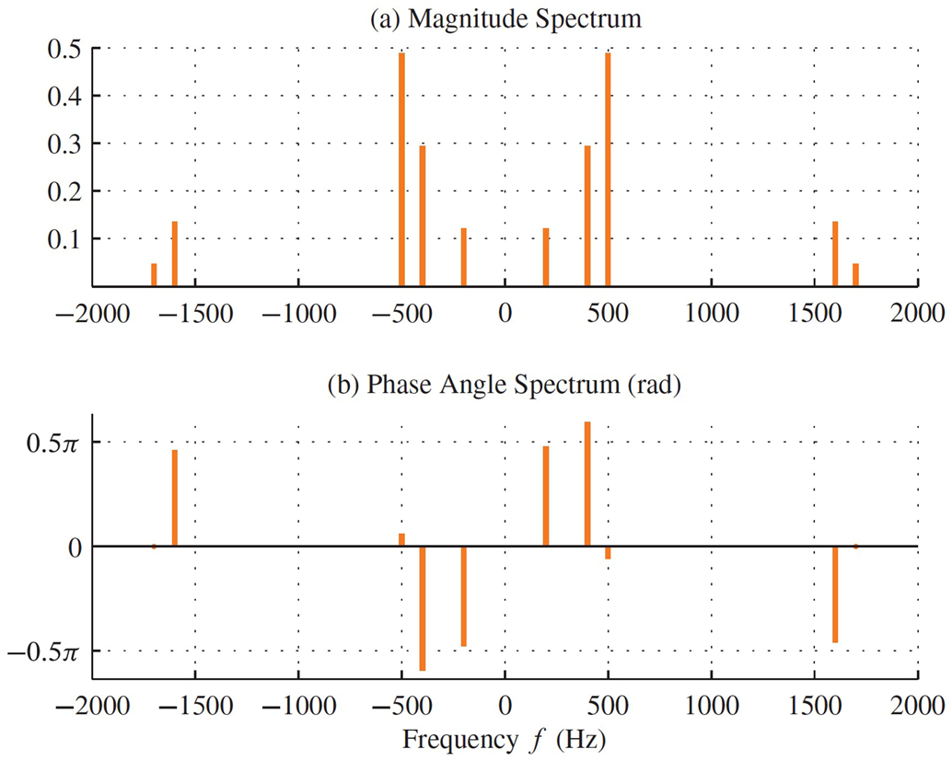
SPECTRUM of VOWEL (Polar Format)
0.5A_{k}
φ_{k}

Slide 31
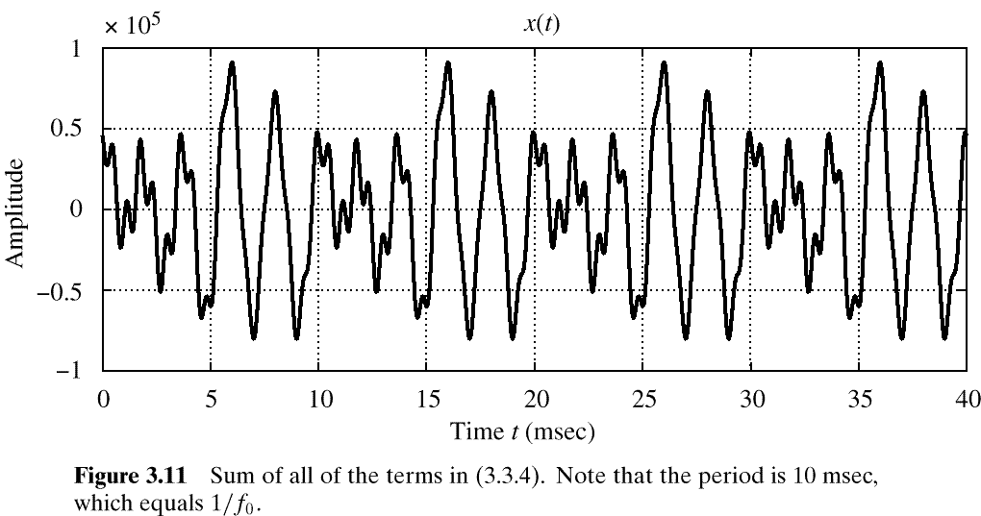
Vowel Waveform (sum of all 5 components)
One epoch or one period
2
1
0
-1
-2
Note that the period is 10 ms, which equals 1/f₀

Slide 32
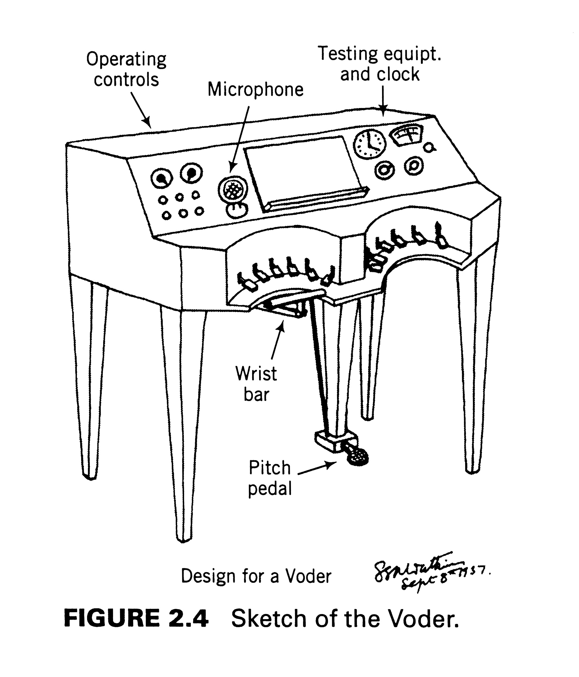
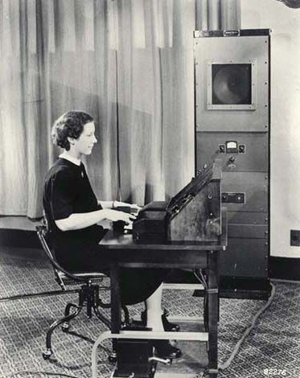
The VODER by Dudley
Resonance controls
Stops & plosives

Slide 33
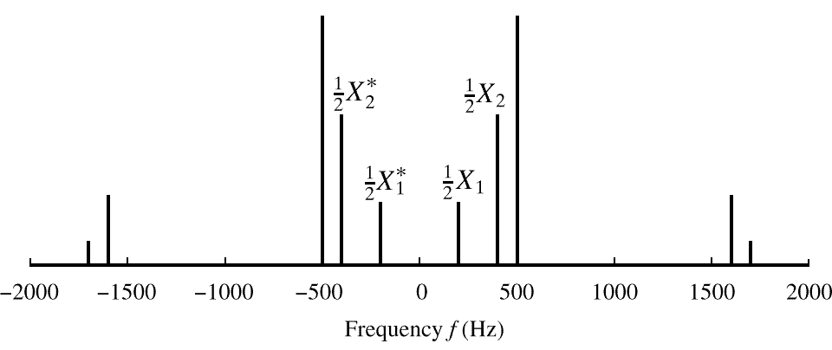
SPECTRUM of VOWEL
Note: Spectrum has 0.5X_{k} (except X_{DC})
Conjugates in negative frequency

Slide 34
Summary: GENERAL FORM

Slide 35
GRAPHICAL SPECTRUM
Freq. in rad/s
-7
0
7
ω
AMPLITUDE, PHASE & FREQUENCY are shown

Slide 36
Phasor cancellation
Interpretation: cosine is sum of two vectors rotating in opposite directions at same speed

