Slide 1
DSP First, 2/e
Lecture 6
Periodic Signals, Harmonics & Time-Varying Sinusoids

Slide 2
License Info for SPFirst Slides
This work released under a Creative Commons License with the following terms:
Attribution
    The licensor permits others to copy, distribute, display, and perform the work. In return, licensees must give the original authors credit.
Non-Commercial
    The licensor permits others to copy, distribute, display, and perform the work. In return, licensees may not use the work for commercial purposes—unless they get the licensor's permission.
Share Alike
    The licensor permits others to distribute derivative works only under a license identical to the one that governs the licensor's work.
Full Text of the License
This (hidden) page should be kept with the presentation

Slide 3
READING ASSIGNMENTS
This Lecture:
  Chapter 3, Sections 3-2 and 3-4
  Chapter 3, Sections 3-6 and 3-7
Next Lectures:
    Fourier Series ANALYSIS
    Sections 3-4 and 3-5

Slide 4
LECTURE OBJECTIVES
Signals with HARMONIC Frequencies
  Add Sinusoids with f_{k} = kf₀
Second Topic: FREQUENCY can change vs. TIME
  Introduce Spectrogram Visualization
  (spectrogram.m) (plotspec.m)
  Chirps:

Slide 5
Signals Studied So Far
Sinusoids
Sum of sinusoids of same frequency
General form: (finite) sum of sinusoids
  Periodic signals
In this lecture

Slide 6
SPECTRUM DIAGRAM
Recall Complex Amplitude vs. Freq
–250
–100
0
100
250
f (in Hz)

Slide 7
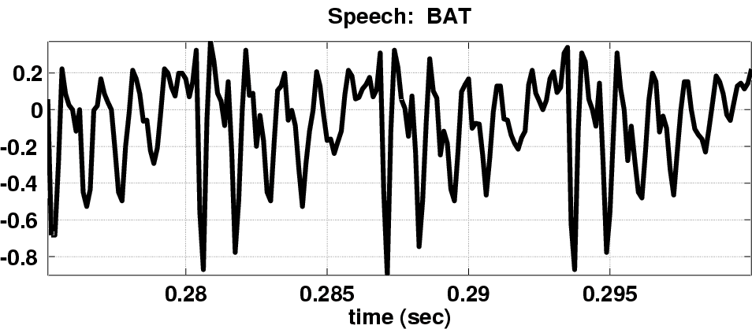
SPECTRUM for PERIODIC ?
Nearly Periodic in the Vowel Region
  Period is (Approximately) T = 0.0065 sec

Slide 8
Harmonic Signal

Slide 9
Define FUNDAMENTAL FREQ
Main point:
for periodic signals, all spectral lines have frequencies that are integer multiples of the fundamental frequency

Slide 10
Harmonic Signal Spectrum

Slide 11
Periodic Signal: Example
Fundamental frequency

Slide 12
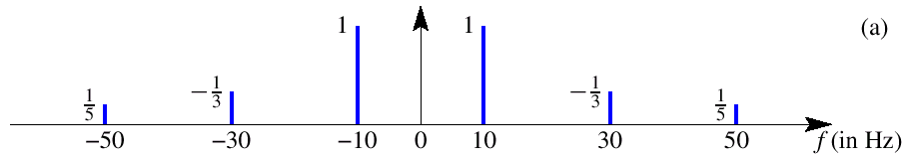
Harmonic Spectrum (3 Freqs)
3rd
5th
What is the fundamental frequency?
10 Hz

Slide 13
POP QUIZ: FUNDAMENTAL
Here’s another spectrum:
–24
–10.4
0
10.4
24
f (in Hz)
What is the fundamental frequency?
(0.1)GCD(104,240) = (0.1)(8)=0.8 Hz

Slide 14
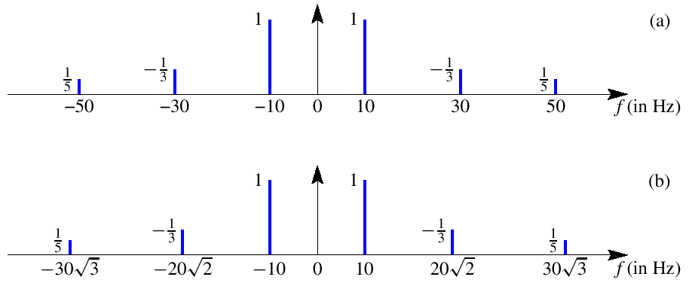
IRRATIONAL SPECTRUM
SPECIAL RELATIONSHIP
to get a PERIODIC SIGNAL
NON-PERIODIC SIGNAL

Slide 15
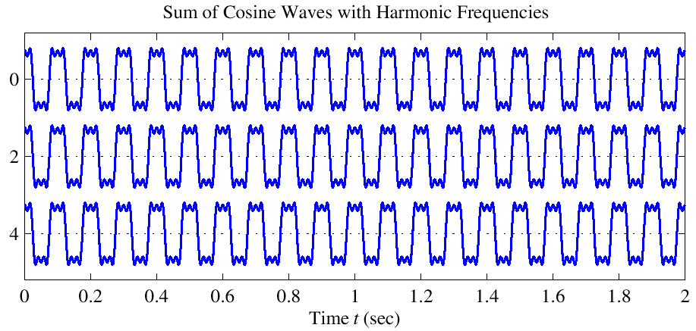
Harmonic Signal (3 Freqs)
T=0.1
PERIODIC

Slide 16
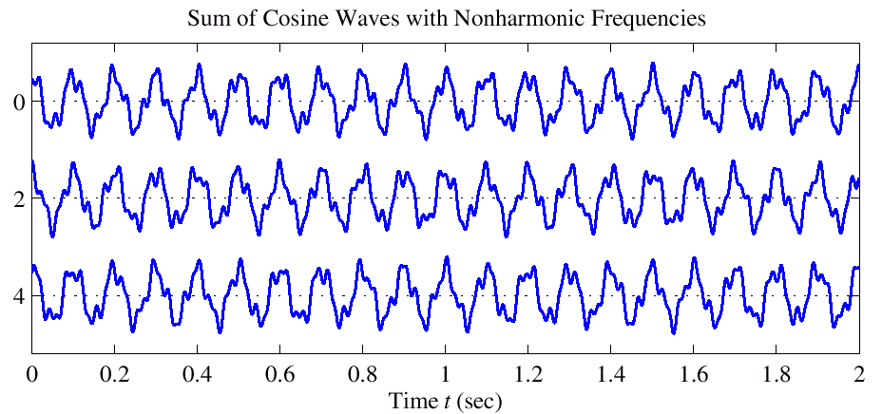
NON-Harmonic Signal
NOT
PERIODIC

Slide 17
FREQUENCY ANALYSIS
Now, a much HARDER problem
Given a recording of a song, have the computer write the music
Can a machine extract frequencies?
  Yes, if we COMPUTE the spectrum for x(t)
    During short intervals

Slide 18
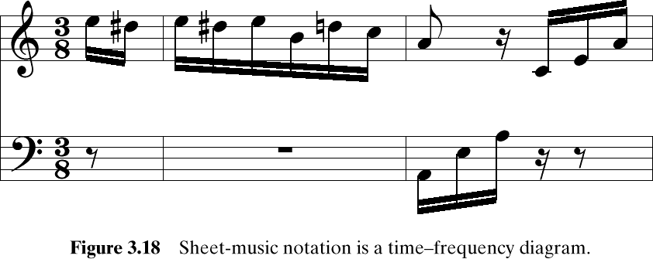
Time-Varying FREQUENCIES Diagram
A-440
Frequency is the vertical axis
Time is the horizontal axis

Slide 19
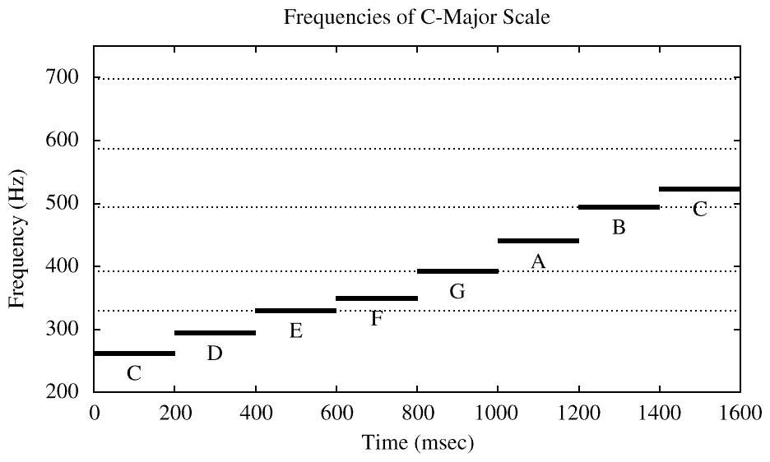
SIMPLE TEST SIGNAL
C-major SCALE: stepped frequencies
  Frequency is constant for each note
IDEAL

Slide 20
SPECTROGRAM
SPECTROGRAM Tool
  MATLAB function is spectrogram.m
  SP-First has plotspec.m & spectgr.m
ANALYSIS program
  Takes x(t) as input
  Produces spectrum values X_{k}
  Breaks x(t) into SHORT TIME SEGMENTS
    Then uses the FFT (Fast Fourier Transform)

Slide 21
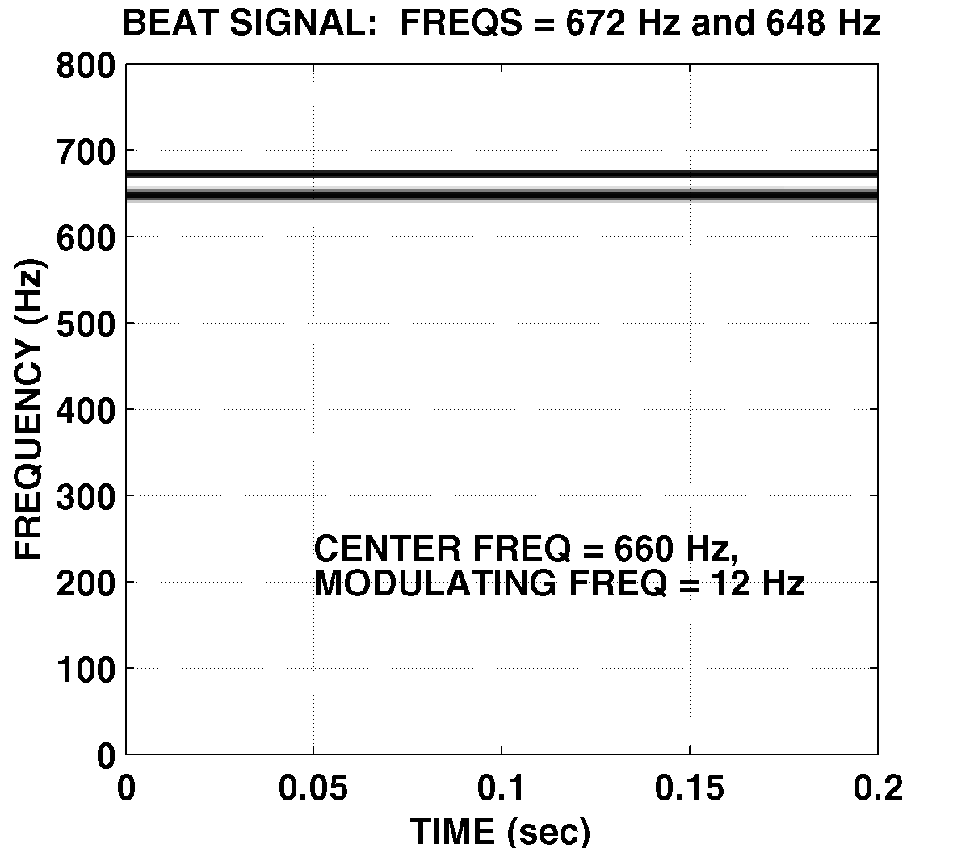
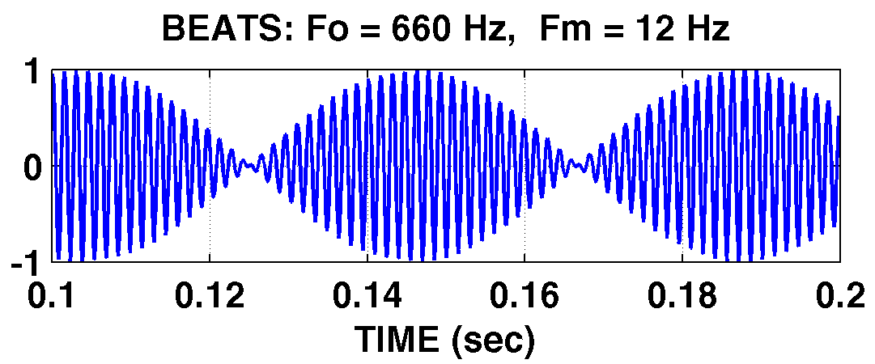
SPECTROGRAM EXAMPLE
Two Constant Frequencies: Beats

Slide 22
AM Radio Signal
Same form as BEAT Notes, but higher in freq

Slide 23
SPECTRUM of AM (Amplitude Modulation)
SUM of 4 complex exponentials:
–672
–648
0
648
672
f (in Hz)
What is the fundamental frequency?
648 Hz ?
24 Hz ?

Slide 24
STEPPED FREQUENCIES
C-major SCALE: successive sinusoids
  Frequency is constant for each note
IDEAL

Slide 25
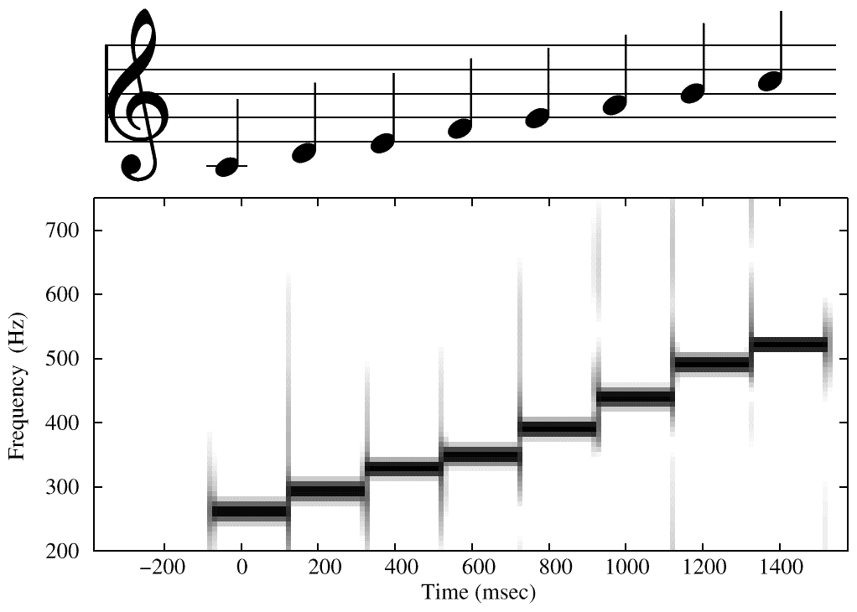
SPECTROGRAM of C-Scale
Sinusoids ONLY
From SPECTROGRAM
ANALYSIS PROGRAM
ARTIFACTS at Transitions

Slide 26
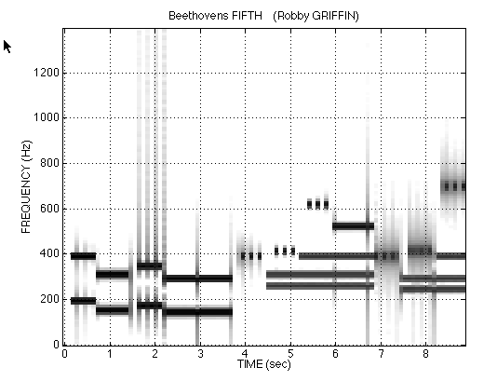
Spectrogram of LAB SONG
Sinusoids ONLY
Analysis Frame = 40ms
ARTIFACTS at Transitions

Slide 27
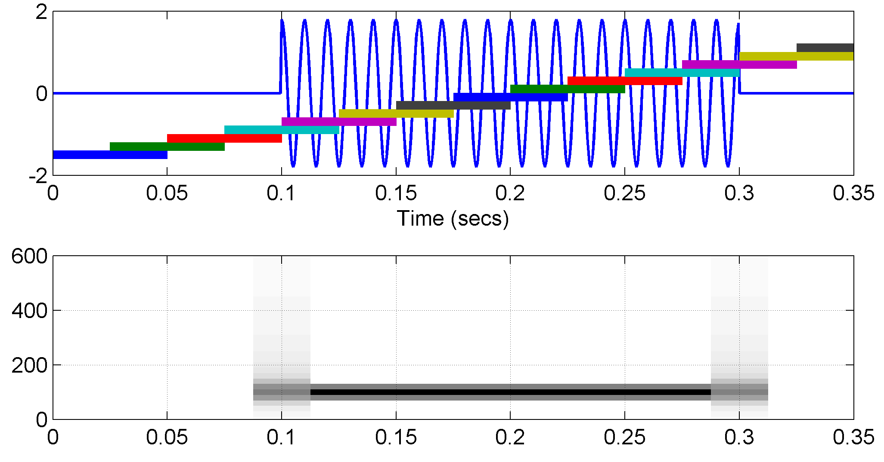
Overlapping Sections in Spectrograms (useful in Labs)
50% overlap is common
Consider edge effects when analyzing a short sinusoid
SECTION
LOCATIONS
MIDDLE of SECTION
is REFERENCE TIME

Slide 28
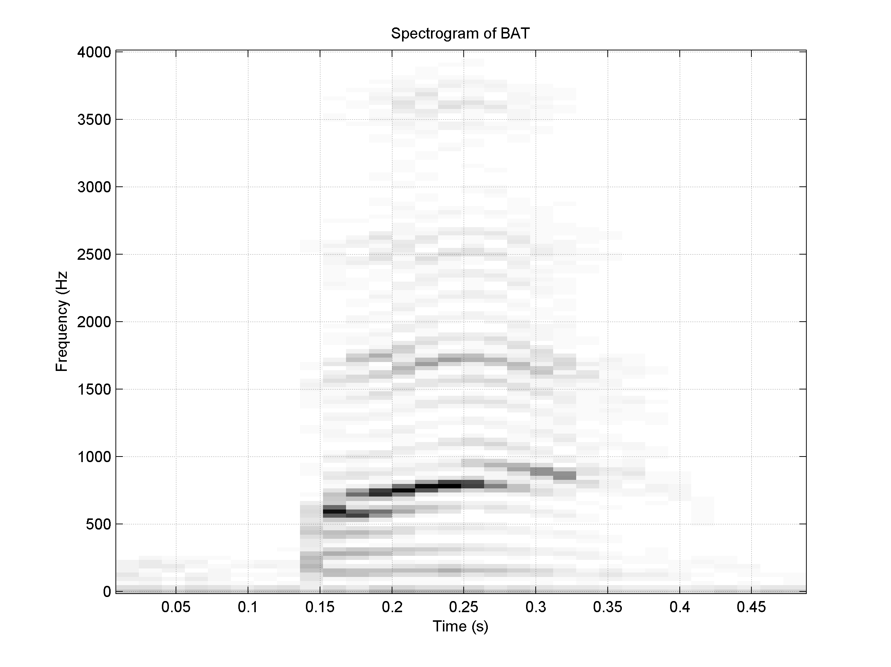
Spectrogram of BAT (plotspec)

Slide 29
Time-Varying Frequency
Frequency can change vs. time
  Continuously, not stepped
FREQUENCY MODULATION (FM)
CHIRP SIGNALS
  Linear Frequency Modulation (LFM)
VOICE

Slide 30
New Signal: Linear FM
Called Chirp Signals (LFM)
  Quadratic phase
Freq will change LINEARLY vs. time
  Example of Frequency Modulation (FM)
  Define “instantaneous frequency”
QUADRATIC

Slide 31
INSTANTANEOUS FREQ
Definition
For Sinusoid:
Derivative
of the “Angle”
Makes sense

Slide 32
INSTANTANEOUS FREQ of the Chirp
Chirp Signals have Quadratic phase
Freq will change LINEARLY vs. time

Slide 33
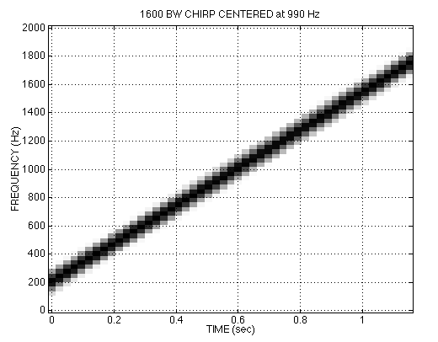
CHIRP SPECTROGRAM

Slide 34
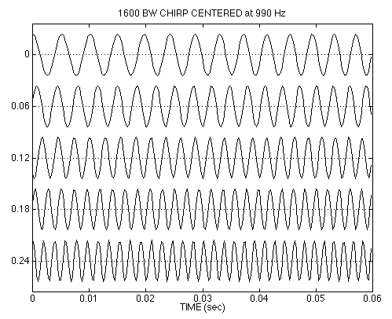
CHIRP WAVEFORM

Slide 35
OTHER CHIRPS
ψ(t) can be anything:
ψ(t) could be speech or music:
  FM radio broadcast

Slide 36
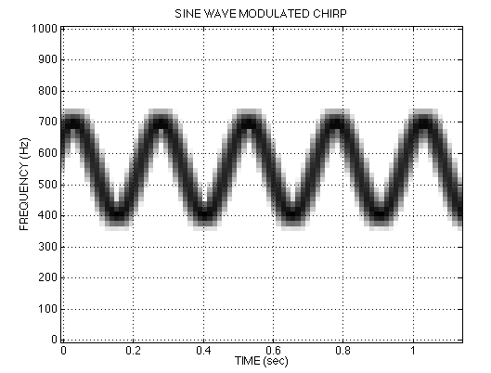
SINE-WAVE FREQUENCY MODULATION (FM)
Look at CD-ROM Demos in Ch 3

Slide 37
Problem Solving Skills
Math Formula
  Sum of Cosines
  Amp, Freq, Phase
Recorded Signals
  Speech
  Music
  No simple formula
Plot & Sketches
  S(t) versus t
  Spectrum
MATLAB
  Numerical
  Computation
  Plotting list of numbers

